Slide 1

Network Layer: IPv4 Functions
Lecture 9 | CSE421 – Computer Networks
Department of Computer Science and Engineering School of Data & Science

Slide 2
Objectives
Short overview of the Network Layer
Packet Switching: Virtual Circuits & Datagram Networks
IPv4 Packet Format
IP Fragmentation & Reassembly
ICMP
Ping
Traceroute

Slide 3
















The Network Layer
Encapsulates data into packets on the sending side.
Network Layer protocols operates on hosts and routers.
Routers inspect IP header fields for forwarding.
Delivers segments to the transport layer on the receiving side.
application
transport
network
data link
physical
network
data link
physical
network
data link
physical
network
data link
physical
network
data link
physical
network
data link
physical
network
data link
physical
network
data link
physical
network
data link
physical
network
data link
physical
application
transport
network
data link
physical
network
data link
physical
network
data link
physical

Slide 4
Functions of Network Layer
Routing:
Finds the best path from source → destination
Done by routing algorithms
Analogy: planning a trip before you travel
Forwarding:
move packets from router’s input to appropriate router output
Analogy: process of getting through a single interchange
routing algorithm
local forwarding table
header value
output link
0100
0101
0111
1001
3
2
2
1
0111
1
3
2
value in arriving
packet’s header

Slide 5
Packet Switching
Notes:
Data Communications and Networking. Behrouz A. Forouzan
Section 18.2

Slide 6
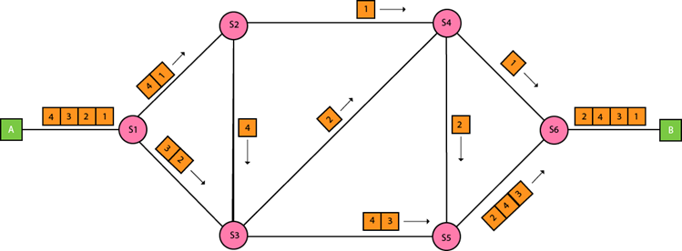
Packet Switching
Packet Switching is a method of transferring data across a network by breaking it into smaller packets.
Two type of networks based on packet switching
Datagram Networks
Virtual Circuit Networks

Slide 7

Datagram networks
No Call Setup:
Devices can send data immediately without establishing a connection.
Stateless Routers:
Routers forward packets independently based on their destination IP address.
Packet Forwarding:
Packets from the same source may take different paths to reach the destination.
application
transport
network
data link
physical
application
transport
network
data link
physical
1. Send data
2. Receive data
Notes:
Each router does not maintain information about previously forwarded packets.

Slide 8
Virtual Circuits: Signaling Protocols
Call Setup:
A connection (virtual circuit) is established between sender and receiver before data transfer.
Stateful Routers:
Routers maintain information about active connections (virtual circuits).
Packet Forwarding:
All packets follow the same path through the network.
application
transport
network
data link
physical
5. Data flow begins
6. Receive data
application
transport
network
data link
physical
4. Call connected
3. Accept call
1. Initiate call
2. incoming call
Notes:
Example:
Asynchronous Transfer Mode (ATM) or MPLS (Multiprotocol Label Switching) networks.

Slide 9


Router architecture overview
high-level view of generic router architecture:
routing, management
control plane (software)
operates in millisecond
time frame
routing
processor
forwarding data plane (hardware) operates in nanosecond timeframe
high-speed
switching
fabric
router input ports
router output ports

Slide 10
Control Plane – the brain!
Control plane builds the routing table using routing protocols.
It creates the forwarding table FIB (Forwarding Information Base), a simplified version of routing table.
The FIB may be created using
simple destination-based rules
or more advanced generalized rules.
Control plane installs this FIB into every input port.
Decentralized Switching

Slide 11
Data Plane – the hands and legs!
How input ports use the FIB?
Forwarding rules can be:
Destination-based forwarding :
Uses only destination IP to choose output port
If destination = 200.20.20.0/24 → send to port s0/0/0.
Generalized forwarding :
Admins can add multiple header fields (IP, protocol, port, etc.) Or special rules (QoS)
If video packet (UDP, port 5000) → high-priority queue.
These rules are stored in the FIB created by the control plane

Slide 12

Input port functions
lookup,
forwarding
queueing
line
termination
link
layer
protocol
(receive)
switch
fabric
physical layer:
Converts signal → digital bits
link layer:
Removes data link header/trailer
Checks for errors
Extracts the IP packet
Frame
Notes:
Green box is a physical layer responsible for receiving bit level transmission. Copper, fiber wireless.
Link layer in blue – bit assemble into Ethernet frame. We will discuss this in details in chapter 6.
But most critical one, is here. Lookup, forwarding function. Lookup and forward is “Match plus action” behavior.
GOAL – processing at “line speed”, otherwise, buffer will be full and packet will be lost

Slide 13

Input port functions
lookup,
forwarding
queueing
line
termination
link
layer
protocol
(receive)
switch
fabric
Datagram or packet
Network layer:
Input port checks packet header
Matches against local FIB copy
Decides output port (using destination-based or generalized rule)
Input Port Queueing
If packets arrive too fast → they wait here
If queue is full → packet is dropped

Slide 14
Internet Protocol IPv4

Slide 15
Internet Network Layer
Host, router network layer functions:
Transport layer: TCP, UDP
Routing protocols
path selection
RIP, OSPF, BGP
IP protocol
addressing conventions
datagram format
packet handling conventions
Network
layer
forwarding
table
ICMP protocol
error reporting
router “signaling”
Link layer
physical layer

Slide 16
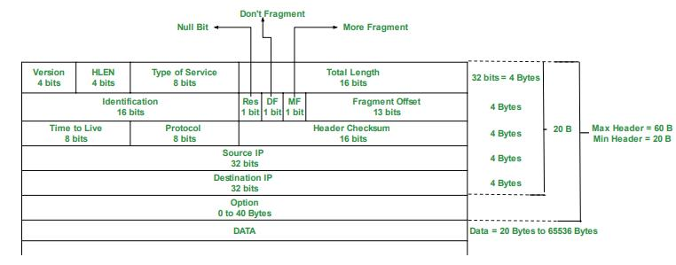
IPv4 Datagram Format
The size of an IP datagram:
The minimum size is 20 bytes (if you have no data)
The maximum size is 65,535 bytes
Notes:
19.1.1 Datagram Format (Data Communications and Networking. Behrouz A. Forouzan)

Slide 17
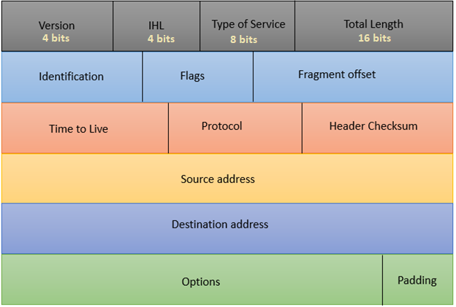
IPv4 Datagram Header Format
Version: value of which IP version is being used. For IPv4 the value will be 4 here.
Internet Header Length: value of the header length, min 20 bytes, max 60 bytes. Shown in 4 byte word. So min value 5, max 15.
Type of Service: for QoS (Quality of Service). To mark the packet to give special treatment or priority.
Total Length: value of the entire size of the IP packet (header and data) in bytes.
Notes:
19.1.1 Datagram Format (Data Communications and Networking. Behrouz A. Forouzan)

Slide 18
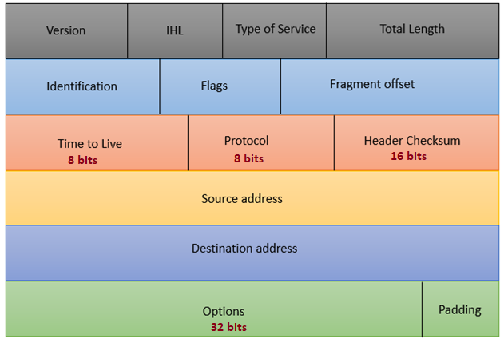
IPv4 Datagram Header Format
Time to Live: maximum number of hops (routers) a packet can travel
Protocol: value tells us which upper layer protocol is present, for example TCP has value 6 and UDP has value 17.
Header Checksum: to check if there are any errors in the header.
Options: value of any extra information. Options are rarely used now.
Padding:
Used only when Options are present. Ensures the header length becomes a multiple of 4 bytes
Notes:
19.1.1 Datagram Format (Data Communications and Networking. Behrouz A. Forouzan)

Slide 19
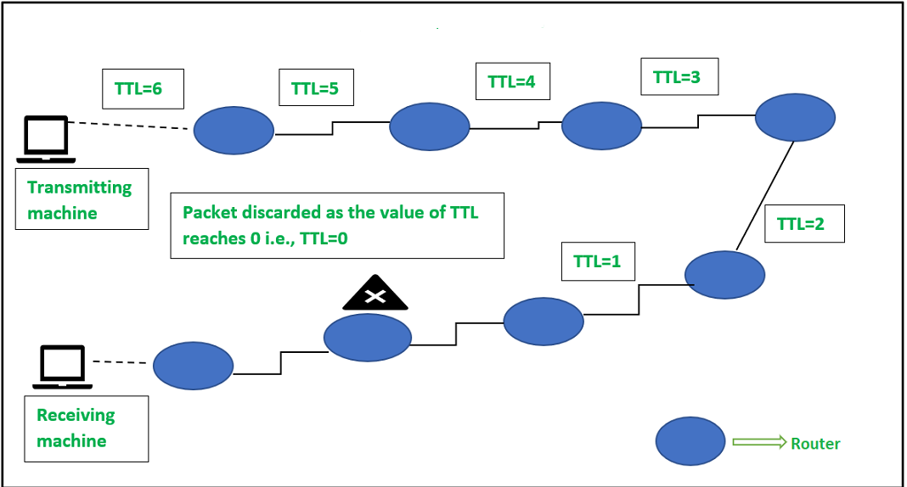
Time to Live - TTL
Maximum number of hops (routers) a packet can traverse before being discarded.
At each hop, the TTL is decreased by 1.
When the TTL reaches 0, the packet is dropped.
And an error message is sent back to the sender.

Slide 20
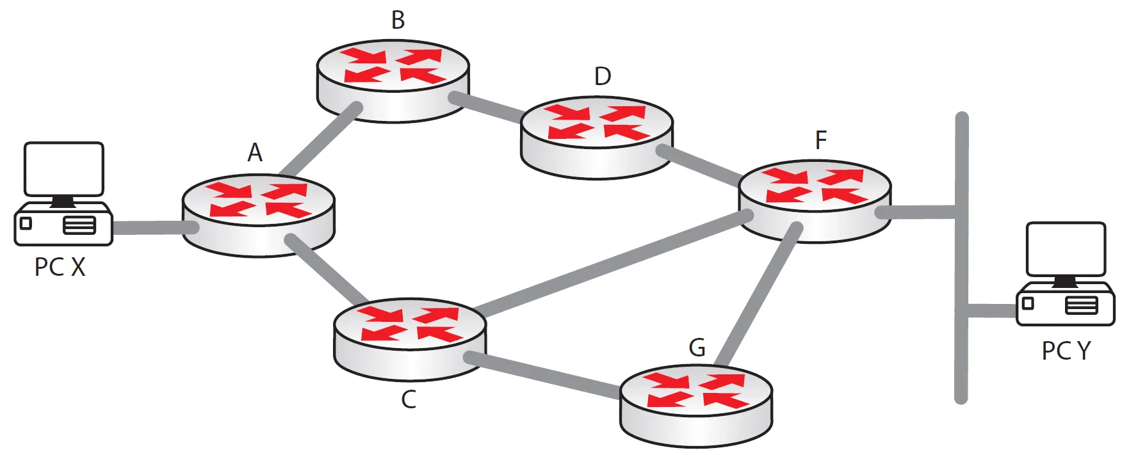
Time to Live - TTL
Not just the "value of hops“
It's a mechanism to prevent packets from looping endlessly in the network.
Ensure finite packet lifetimes.
TTL=63
TTL=62
TTL=64
TTL=64
TTL=59
TTL=61
TTL=60
TTL=60

Slide 21
IPv4 Datagram Format
Notes:
19.1.1 Datagram Format (Data Communications and Networking. Behrouz A. Forouzan)

Slide 22

IP Fragmentation & Reassembly
fragmentation:
in: one large datagram (4000 bytes)
out: 3 smaller datagrams
Network links have MTU
Maximum transmission unit or maximum transfer size
Different link types have different MTUs
Link MTU: 1500bytes
reassembly

Slide 23
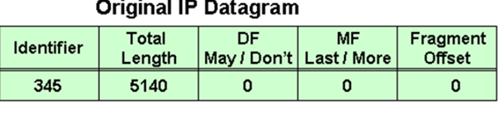
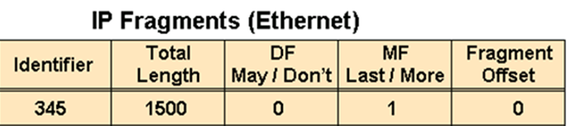




IP Fragmentation & Reassembly
Data 5140=> 20(H)+5120(D)
MTU=1500 => 20(H)+1480(D)
1st fragment : 5120-1480=3640
2nd fragment : 3640-1480=2160
Last/4th Segment : 680+20=700
3rd fragment : 2160-1480=680
1st / start byte number
Notes:
Another example – for students to work out

Slide 24
IP Fragmentation & Reassembly
Extra Example
Example:
4000 Bytes of datagram
MTU = 1500 Bytes
length
=4000
ID
=122
DF
=0
MF
=0
offset
=0
offset = 1480/8
One large datagram becomes
several smaller datagrams
offset = 2960/8
1480 bytes in data field
DF – Don’t Fragment Bit
Value 0 or 1
length
=1500
ID
=122
DF
=0
MF
=1
offset
=0
Fragment Offset
The value of the offset is measured in units of 8 bytes.
length
=1500
ID
=122
DF
=0
MF
=1
offset
=185
length
=1040
ID
=122
DF
=0
MF
=0
offset
=370
Notes:
The value of the offset is measured in units of 8 bytes.
This is done because the length of the offset field is only 13 bits long and cannot represent a sequence of bytes greater than 8191.
This forces hosts or routers that fragment datagrams to choose the size of each fragment so that the first byte number is divisible by 8.

Slide 25
ICMP
Internet Control Message Protocol

Slide 26
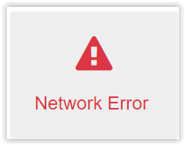


ICMP
It helps devices send error messages and status updates.
Functions:
Reporting errors in the network
Checking reachability (Is the host alive?)
Diagnosing delays and congestion
Key Points:
ICMP does not carry actual user data
Mainly used by the operating systems for network management
Example of ICMP in practice
Ping
Traceroute

Slide 27
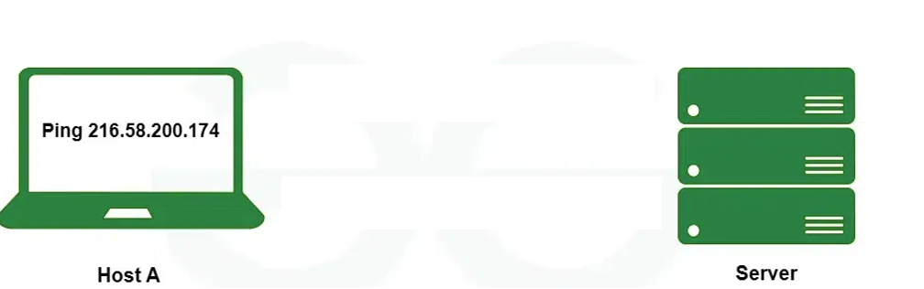


Ping
Packet Internet Groper and is a network utility tool.
Purpose:
Checks if a device is reachable
Measures the time it takes for data to travel (round-trip time).
Mechanism:
Sends ICMP Echo Request packets
Receives Echo Reply packets.
Results:
Displays the number of packets sent/received/lost
The time taken(delay).
Commands: ping 216.58.200.174

Slide 28
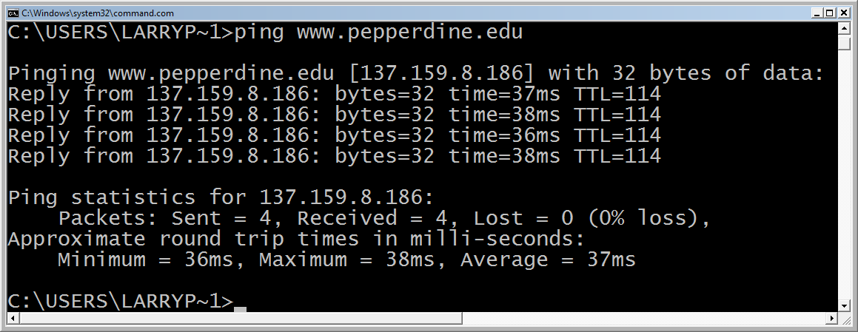
Ping
Questions :
Why 4 replies?
What the time refer to?
What is the TTL refer to?
Notes:
TTL is 114, which means that the original TTL value (commonly 128 or 255 depending on the operating system) was decremented by 14 during the journey. This suggests the packet passed through 14 routers. Why it matters: The TTL value in the ping response indicates how many hops remained before reaching your device. It can give an indirect idea of how far (in terms of network hops) the target is. represents the round-trip time it takes for an ICMP echo request to travel from your device to the target It indicates the latency or delay in the network connection. Lower values mean faster responses and better network performance.Example in the output: The times vary slightly, such as 36ms, 37ms, and 38ms, showing minor variations in network latency.

Slide 29
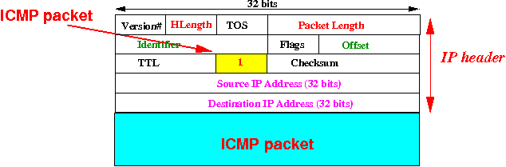
ICMP Packet Format
IP Header 20 bytes | IP Payload/ Data
ICMP Header 8 bytes | ICMP Data (variable)

Slide 30
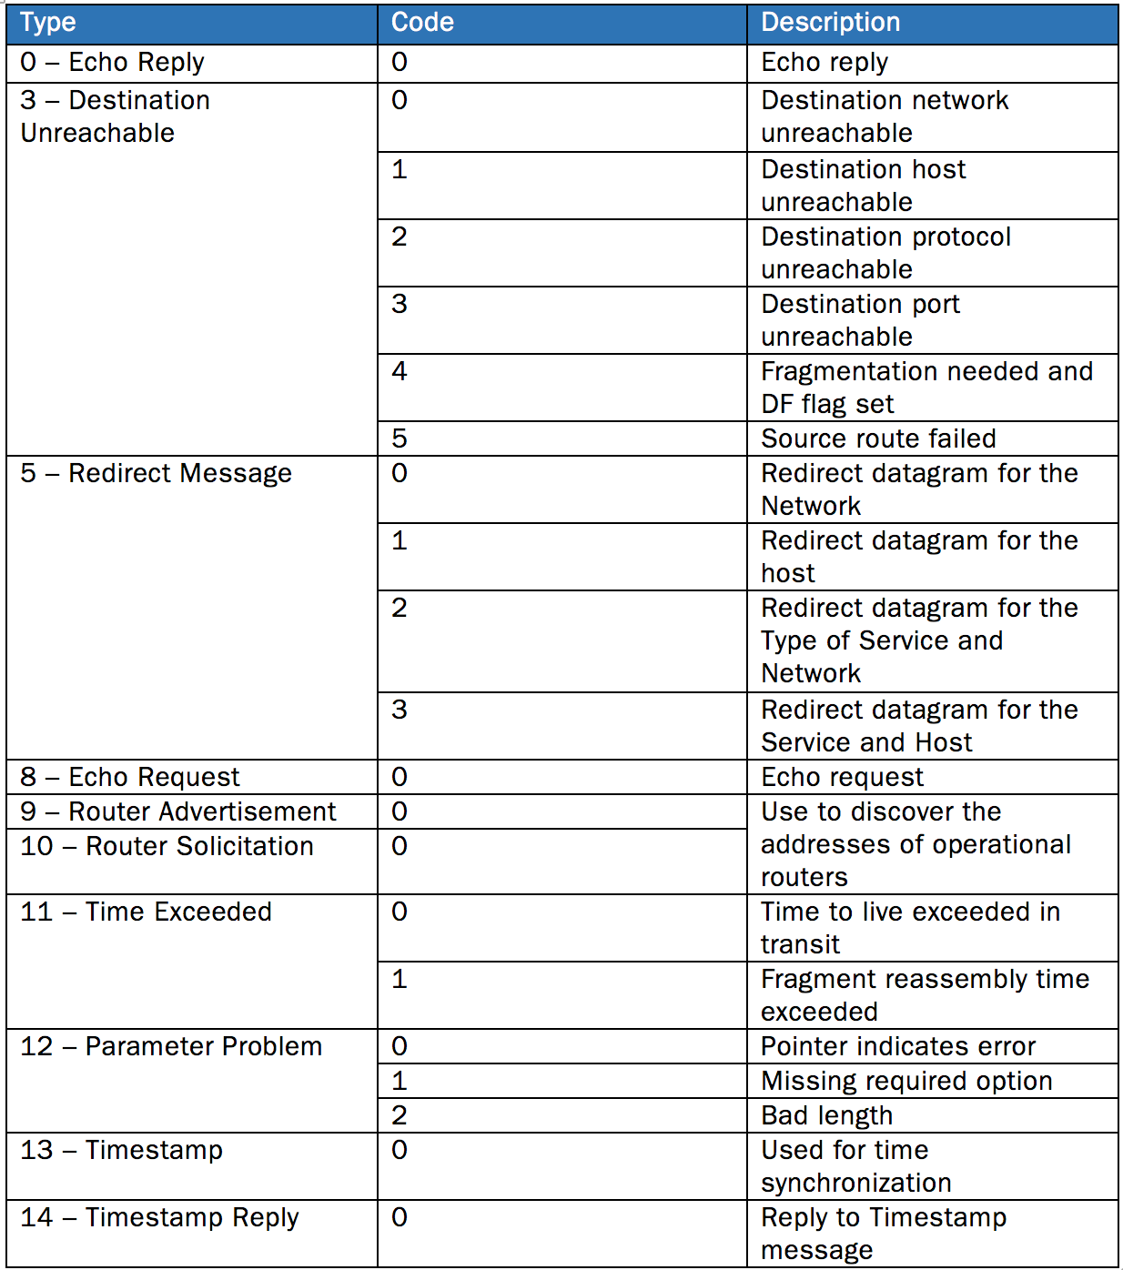
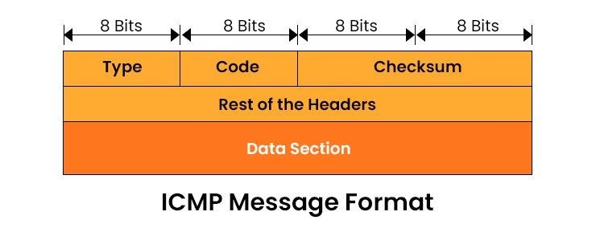
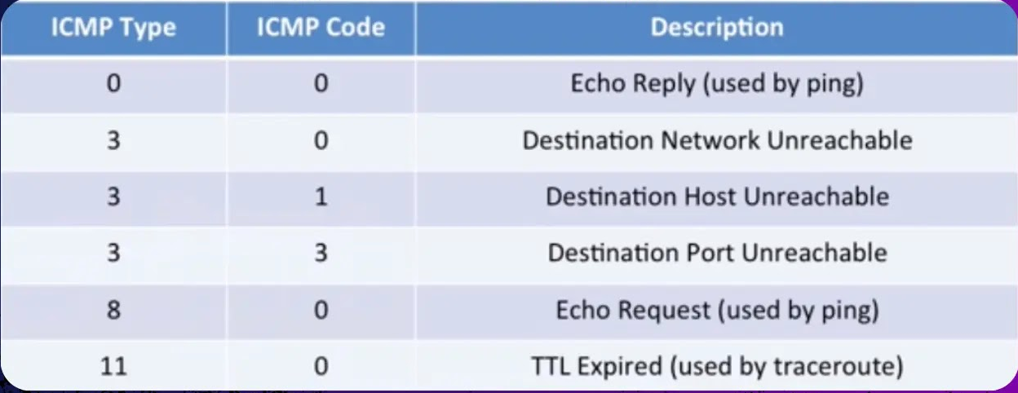
ICMP Packet Format

Slide 31
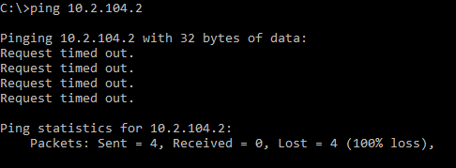
Unsuccessful Ping

Slide 32
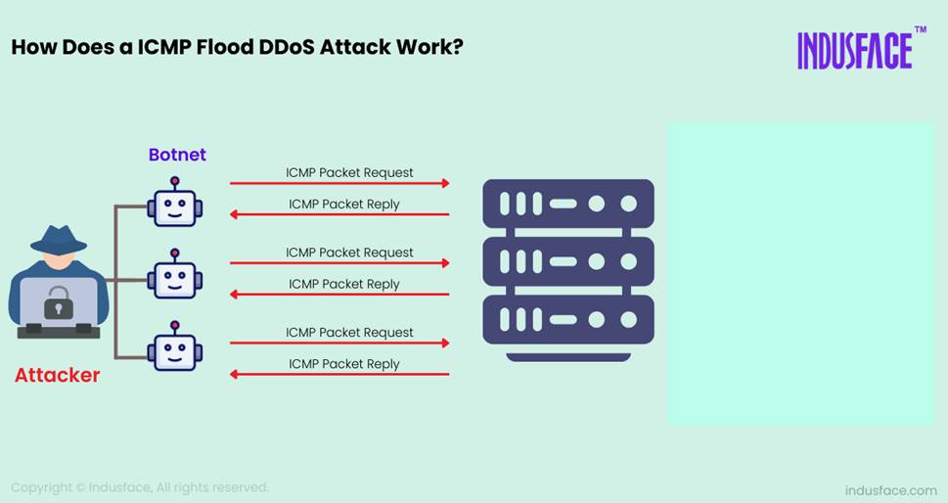
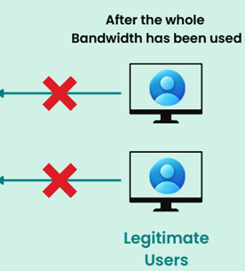
Ping Attacks
ICMP DDOS attack – Zombie Attack:
Notes:
Much like the ping flood method, only multiple computers are being used.
In this instance, the computers that are being used may or may not be aware of the fact that they are attacking a website or network.
Trojans and viruses commonly give the hacker control of a computer, and thus, the ability to use them for attack. In this case the victim computers are called zombies.

Slide 33
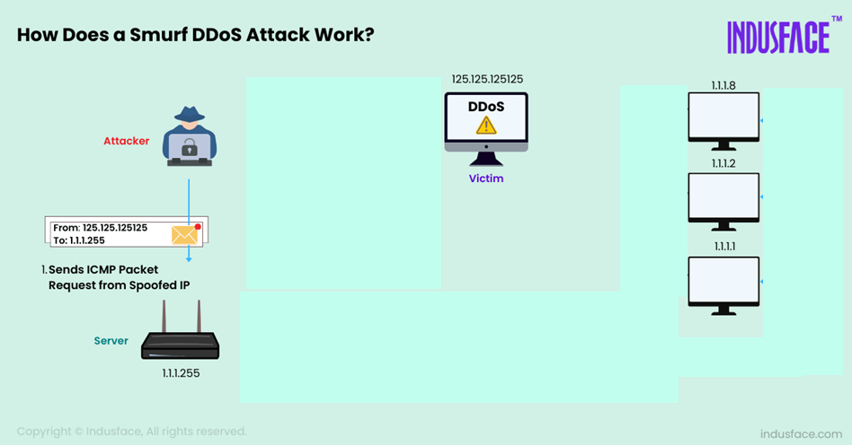
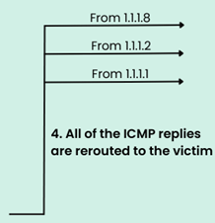




Ping Attacks
ICMP DDOS attack – Packet magnification (or ICMP Smurf):
Notes:
An attacker sends forged ICMP echo packets to vulnerable networks' broadcast addresses. All the systems on those networks send ICMP echo replies to the victim. Prevention: Disable ICMP Echo Requests: Configure firewalls or routers to block incoming ICMP packets, especially "Echo Request" packets, to prevent attackers from exploiting ping.
Use Rate Limiting: Limit the number of ICMP packets a device or network can process per second, reducing the impact of flood attacks.
Prevent IP Spoofing:

Slide 34
IP MTU Discovery with ICMP
Router drops the packet and
Sends ICMP
Frag. Needed
MTU = 2000
MTU = 2000
host
host
router
router
MTU = 1500
MTU = 4000
4000
Length = 4000, Don’t Fragment
IP
Packet

Slide 35
IP MTU Discovery with ICMP
Router drops the packet and
Sends ICMP
Frag. Needed
MTU = 1500
2000
MTU = 2000
host
2000
router
host
router
MTU = 1500
MTU = 4000
Length = 2000, Don’t Fragment
IP
Packet

Slide 36
IP MTU Discovery with ICMP
MTU = 2000
host
host
router
router
MTU = 4000
MTU = 1500
Length = 1500, Don’t Fragment
IP
Packet
When successful, no reply at IP level
“No news is good news”
Higher level protocol might have some form of acknowledgement

Slide 37

Traceroute
Shows the path your packets take through different routers to reach a destination.
Purpose:
Identifies the routers or hops data passes through to reach its destination mostly for troubleshooting
Mechanism:
Sends ICMP packets with TTL = 1, 2, 3…
Each router where TTL becomes 0 sends ICMP Time Exceeded
Traceroute uses these replies to list each hop in order

Slide 38
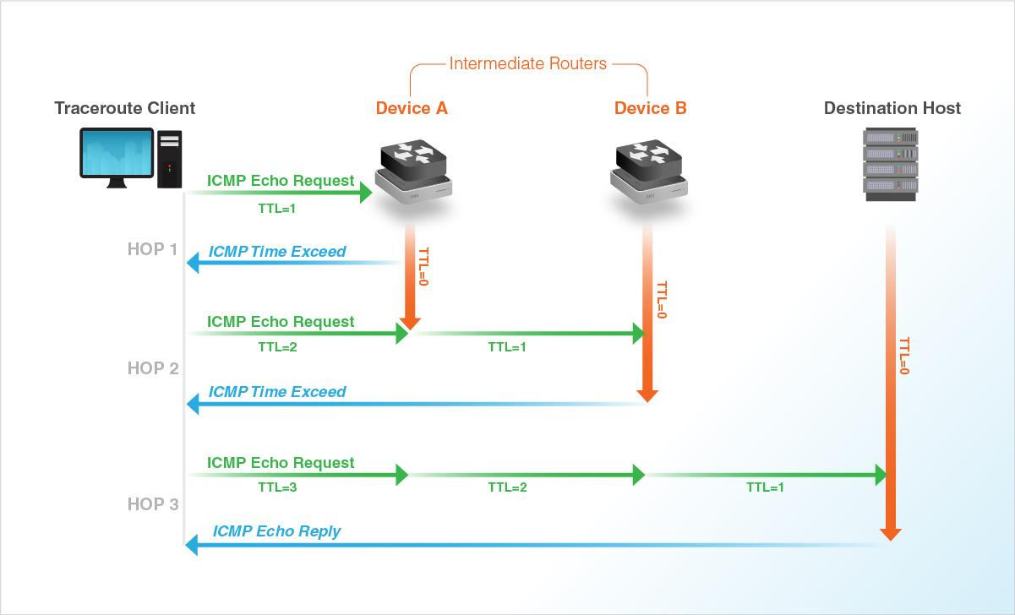
Traceroute

Slide 39
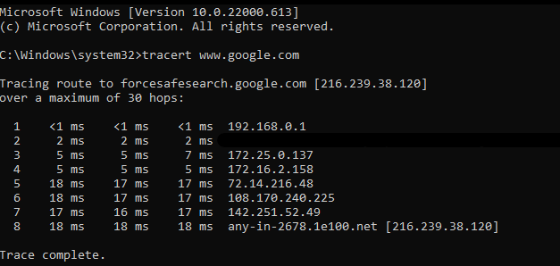
Traceroute
Results The IP or hostname of every hop and the time each hop takes (latency)
Commands:
Unix: traceroute
Cisco IOS: traceroute (trace)
DOS: tracert

Slide 40
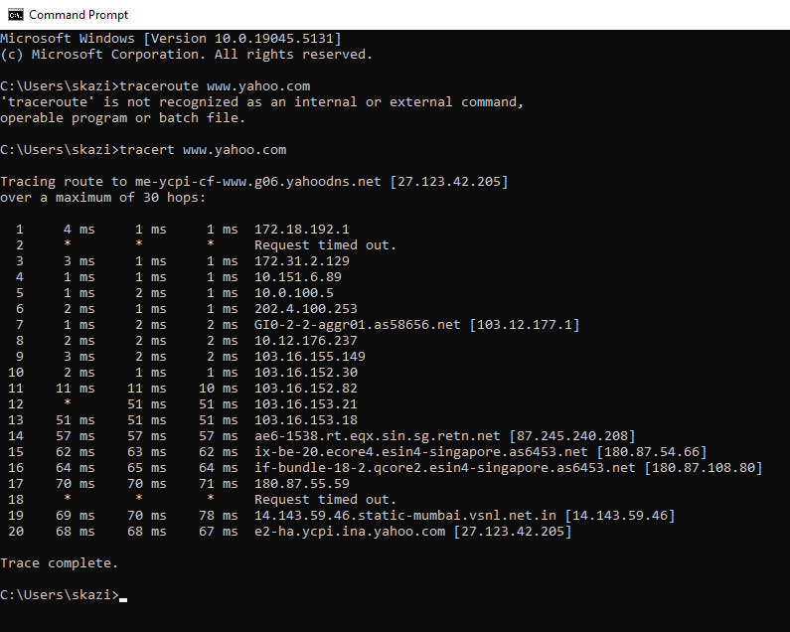
Using Tracert
Hop 1: Our local router or gateway (private IP address).
Hops 2–5: Internal routing within Bracu ISP's private network (non-public IPs).
Hop 6: First public IP, ISP's gateway to the internet.
Hops 7–9: Routing through regional and backbone ISPs.
Hops 10–13: Routing through Singapore (a major internet hub).
Hops 14–19: Routing through Indian networks, ending in Mumbai.
Hop 20: Final destination—Yahoo's server, located in India, near Mumbai.

Slide 41
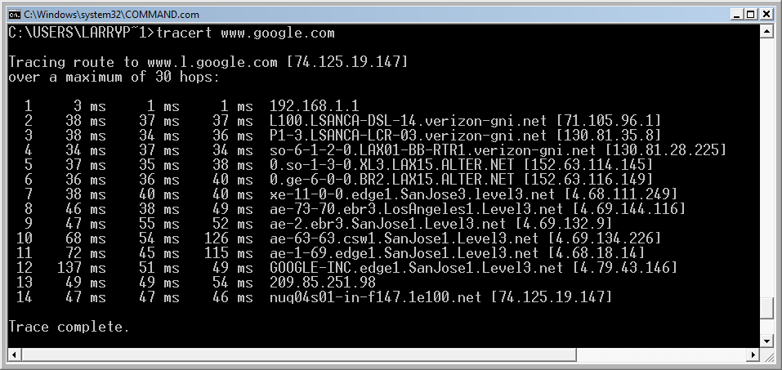
Traceroute: Another example
Hop 1: User LAN router
Hops 2-4: Verizon network (a backbone ISP)
Hops 5-6: Alternet (a backbone ISP)
Hops 7-11: Level 3 (a backbone ISP)
Hops 12-14: the Google LAN

Slide 42
Traceroute: Request Timed Out
This message indicates that the router security settings keep it from revealing its identity or the router and connection are slow.

Slide 43
The End

